Slide 1
GenAI-HyperPersonalisation
Team - techie-minds
GitRepo - https://github.com/ewfx/aidhp-techie-minds
Team Members :
Akshata Chougule (U639518),
Anju Gupta (U846642),
Durgaprasad BN (U758650),
Soumya Rath (U461129)

Slide 2
Problem Statement
Introduction
Hyperpersonalization uses AI and big data to deliver highly customized banking experiences.
Moves beyond traditional segmentation to real-time, individual-specific services.
Aims to enhance customer engagement and loya
Problem Statement
Traditional banking offers generic products and services that do not fully meet individual customer needs.
Customers expect digital, real-time, and tailored financial solutions.
Low personalization leads to disengagement, churn, and missed revenue opportunities.

Slide 3
Future
Hyperpersonalization in banking will move towards:
AI-driven financial assistants
Proactive fraud detection & security measures
Voice and biometric-driven banking experiences
Open banking APIs for seamless integration
Faster turnaround time for the complaints/requests raised.
More engaged customers
Lesser spent on marketing, as now we are moving towards targeted marketing

Slide 4
How this Solution Works
How This Solution Works*
Data Sources Used*
✅ *Customer Profile Data* (Industry, Income, Preferences)
✅ *Social Media Sentiment* (Extracted from posts/comments)
✅ *Transaction History* (Purchases, Investments, Payments)
Core AI Components
Component | Technology Used | Purpose
Sentiment Analysis | Hugging Face transformers | Analyzes customer sentiment from social media
Recommendation Engine | Nearest Neighbors (Scikit-learn) | Finds similar customers & suggests relevant products/services
Bias Detection & Mitigation | AIF360 | Prevents unfair recommendations based on gender, location, etc.
Real-time Adaptation | Flask-SocketIO | Updates recommendations dynamically as user behaviour changes

Slide 5
How this Solution Works
Hyper-Personalization in Action
Step 1: Data Processing & Feature Engineering
Extracts relevant data (Customer Profile, Social Media, Transactions).
Normalizes numerical attributes (Income, Revenue, Age)
Encodes categorical data (Industry, Preferences, Gender)
Step 2: Sentiment Analysis & Intent Detection
Uses *DistilBERT* to analyze user posts/comments.
Classifies sentiment as *positive, negative, or neutral*.
Identifies purchase intent based on social interactions.
Step 3: Adaptive Recommendation Engine
Uses *Nearest Neighbors (KNN with Cosine Similarity)* to find similar users.
Dynamically adjusts recommendations based on *real-time user behavior.
Step 4: Bias Detection & Fairness Optimization
Uses AIF360 to detect potential biases in recommendations.
Applies *Reweighing Algorithm* to ensure fairness in suggestions.
Step 5: Real-Time Personalization via Web App
Built with Flask & SocketIO to *deliver recommendations in real-time*.
Customers get *dynamic recommendations* that evolve with their behaviour.

Slide 6
Key Benefits of This Solution
AI-Driven Personalization: Adapts recommendations dynamically based on user actions.
Multimodal Insights: Uses customer data, transactions, and sentiment analysis for accuracy.
Bias-Free Recommendations: Ensures fair and non-discriminatory personalization.
Scalable & Lightweight: Uses open-source AI models (Hugging Face, AIF360, Scikit-learn) without heavy TPU/GPU dependencies

Slide 7
Conclusion
This Gen AI-powered hyper-personalization system provides a highly adaptive, real-time, and fair recommendation engine by leveraging NLP, ML, and AI fairness techniques. It continuously learns from user interactions to optimize engagement and business decisions dynamically.

Slide 8
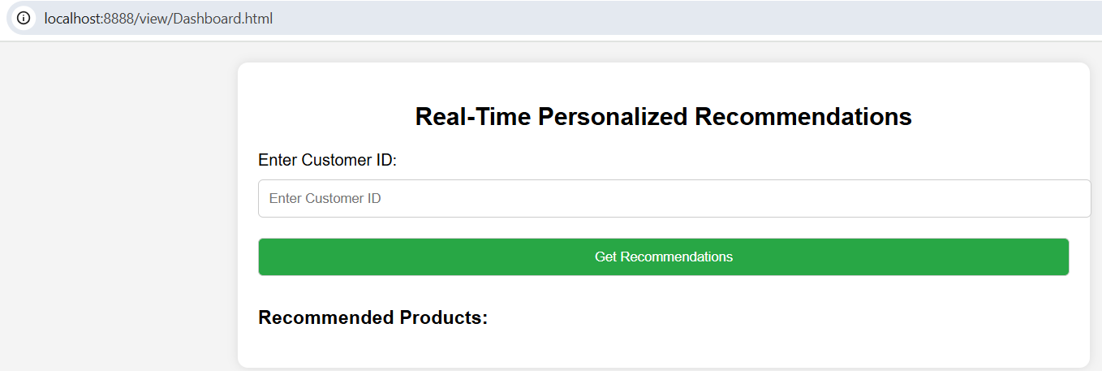
User Interface API - Output

Slide 9
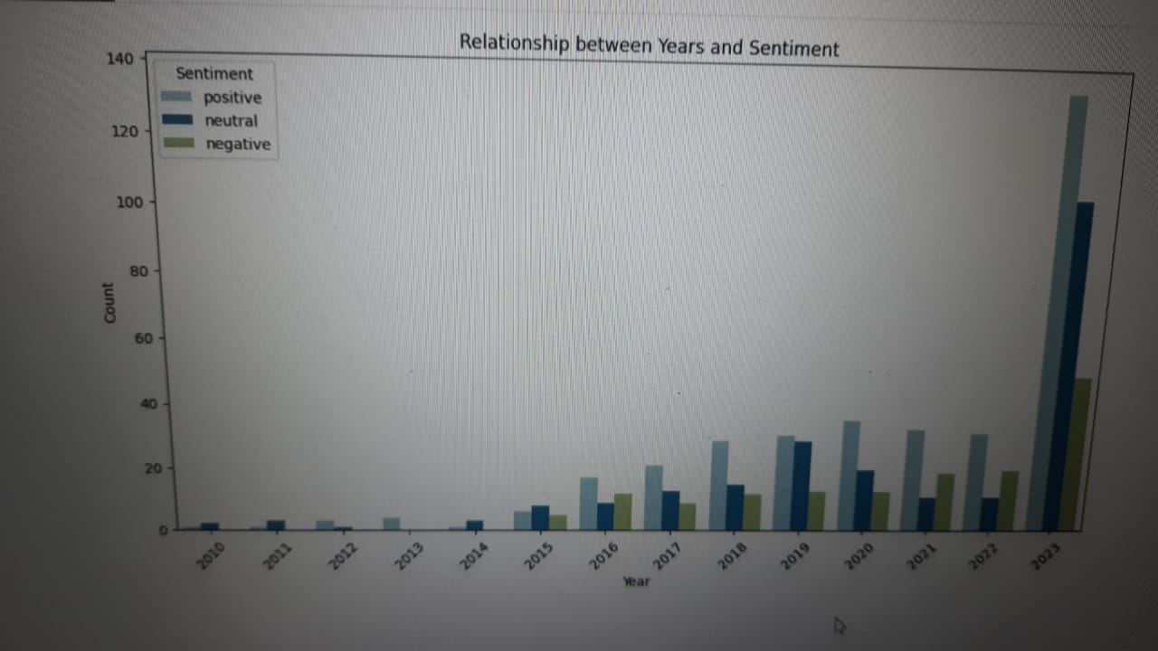
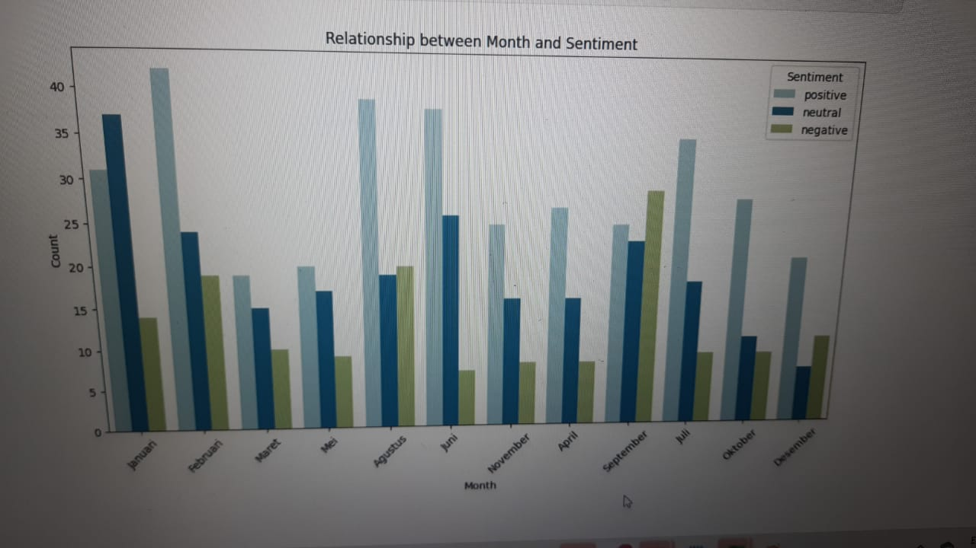
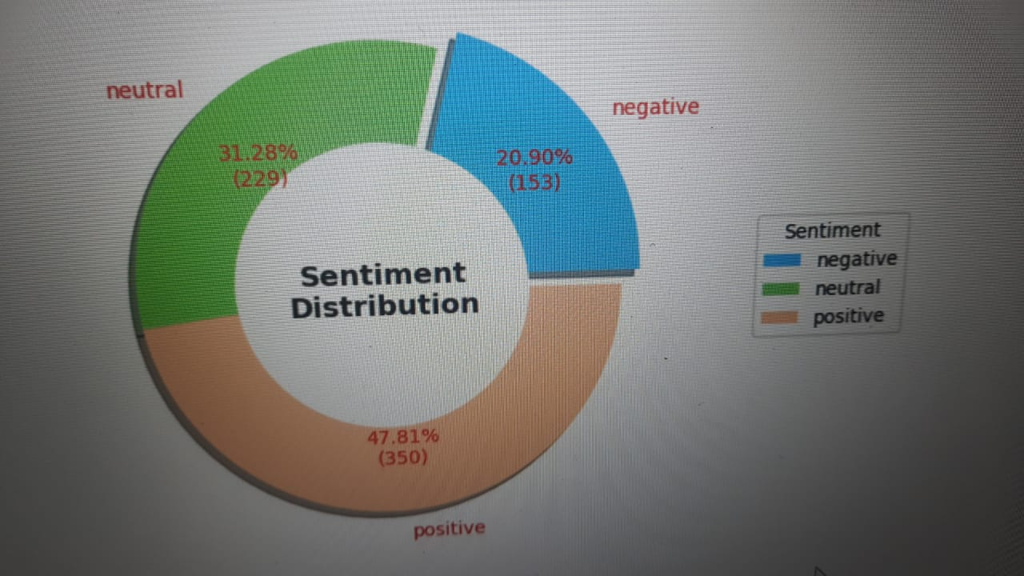
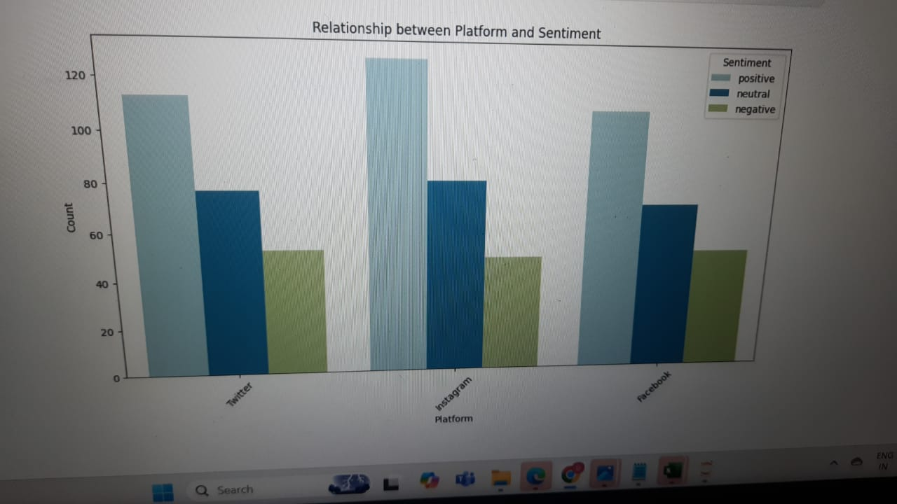
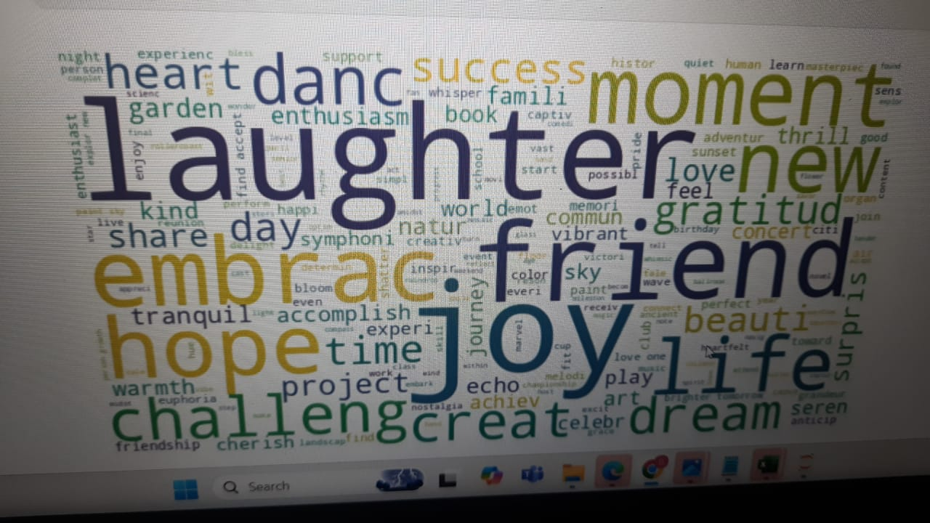
Insights

Slide 10
Thank You
Team Members
Akshata (U639518),
Anju (U846642),
Durgaprasad (U758650),
Soumya (U461129)

